Slide 2
BarCamP
Over 200 trainers attended Lower Normandy GRETA network’s BarCamP, on July 4th 2014, where JOT was presented in a workshop held by the GRETA Sud Normandie training team and the GIP FCIP experts.
The topic of the BarCamp was lifelong vocational guidance in adult education.
The “tribunal des métiers” tool is used in two areas of the network: Vire and Coutances agencies.
The BarCamp was a great opportunity to disseminate the work undertaken so far at transnational level by JOT partners and study the possibilities of its transfer to other areas of our region.

Slide 3
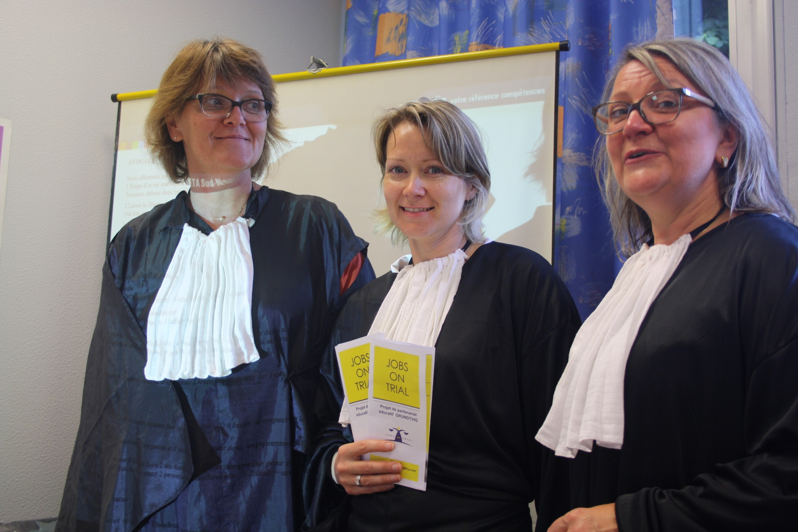

Slide 4
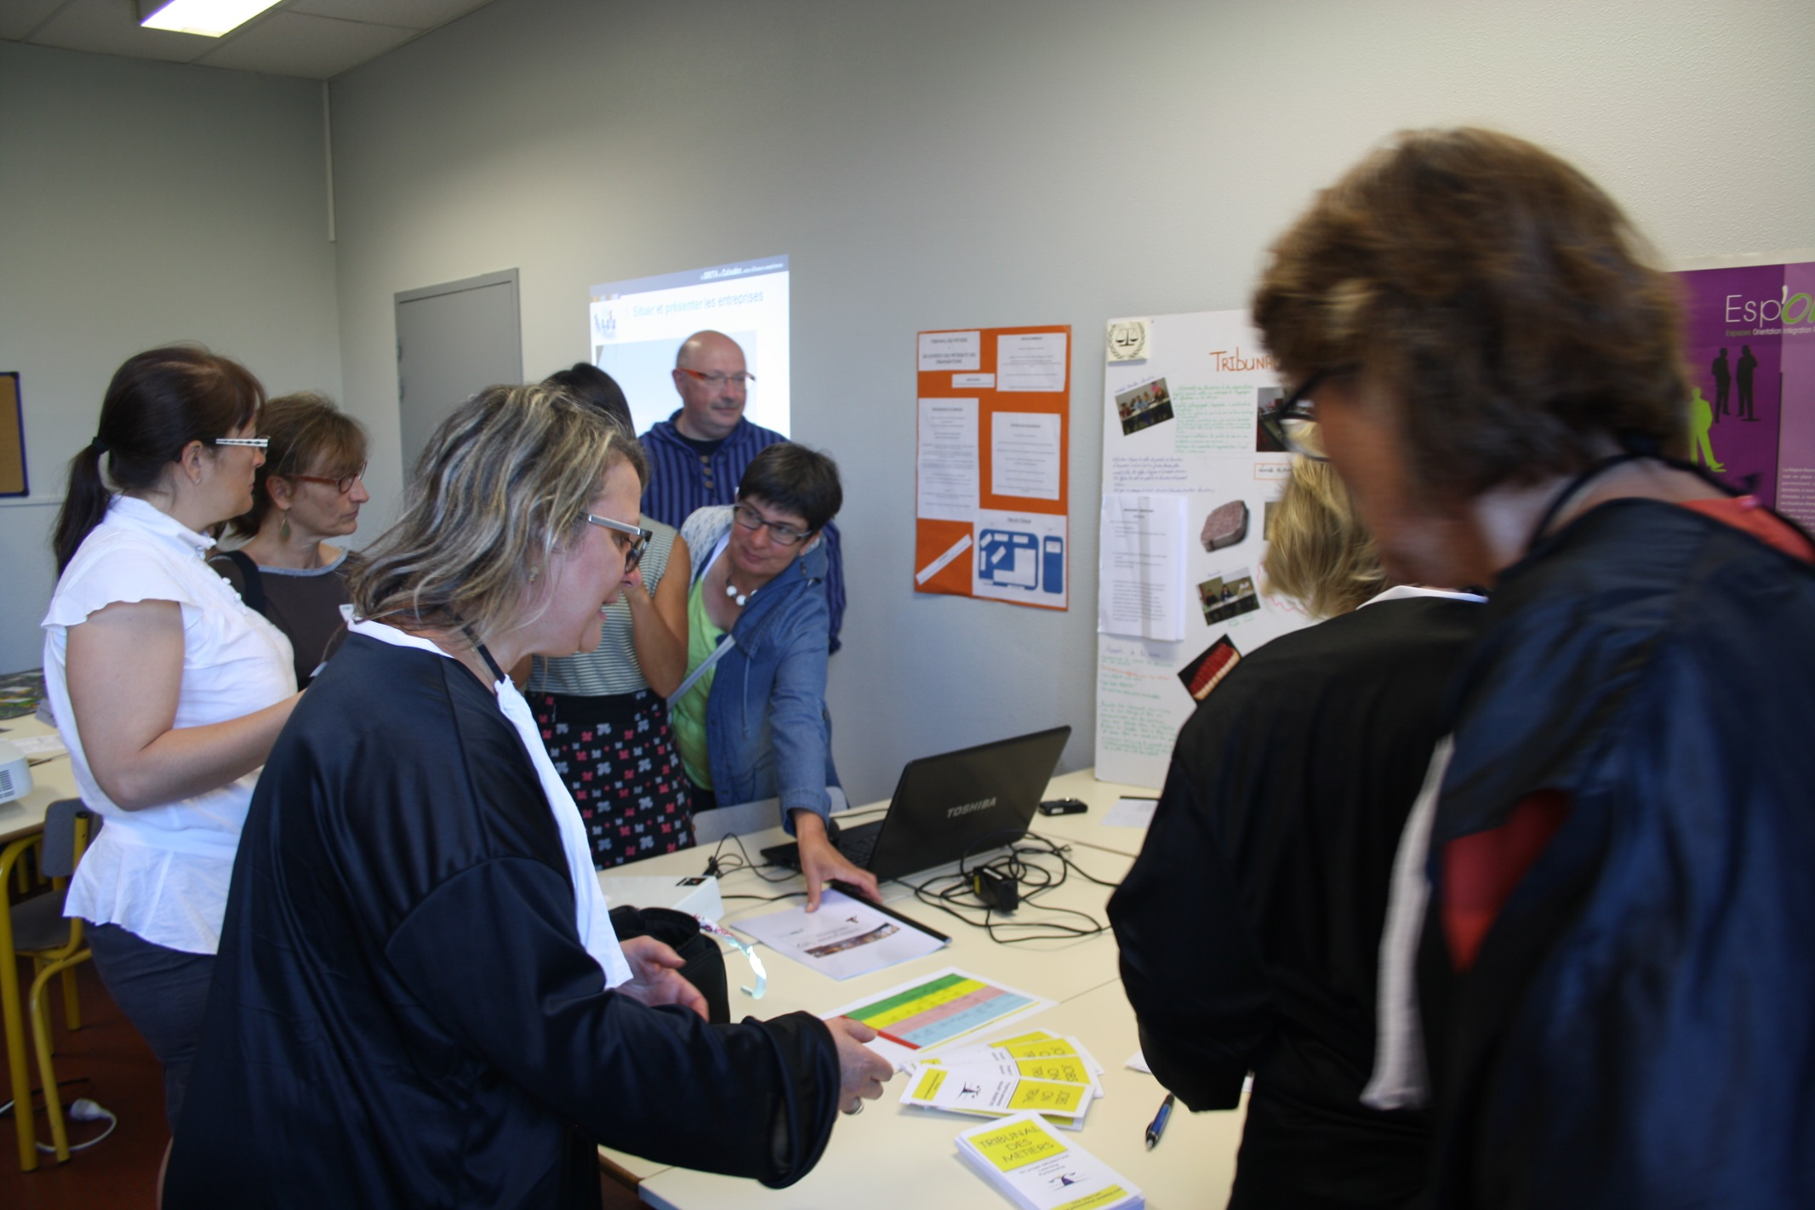

Slide 5
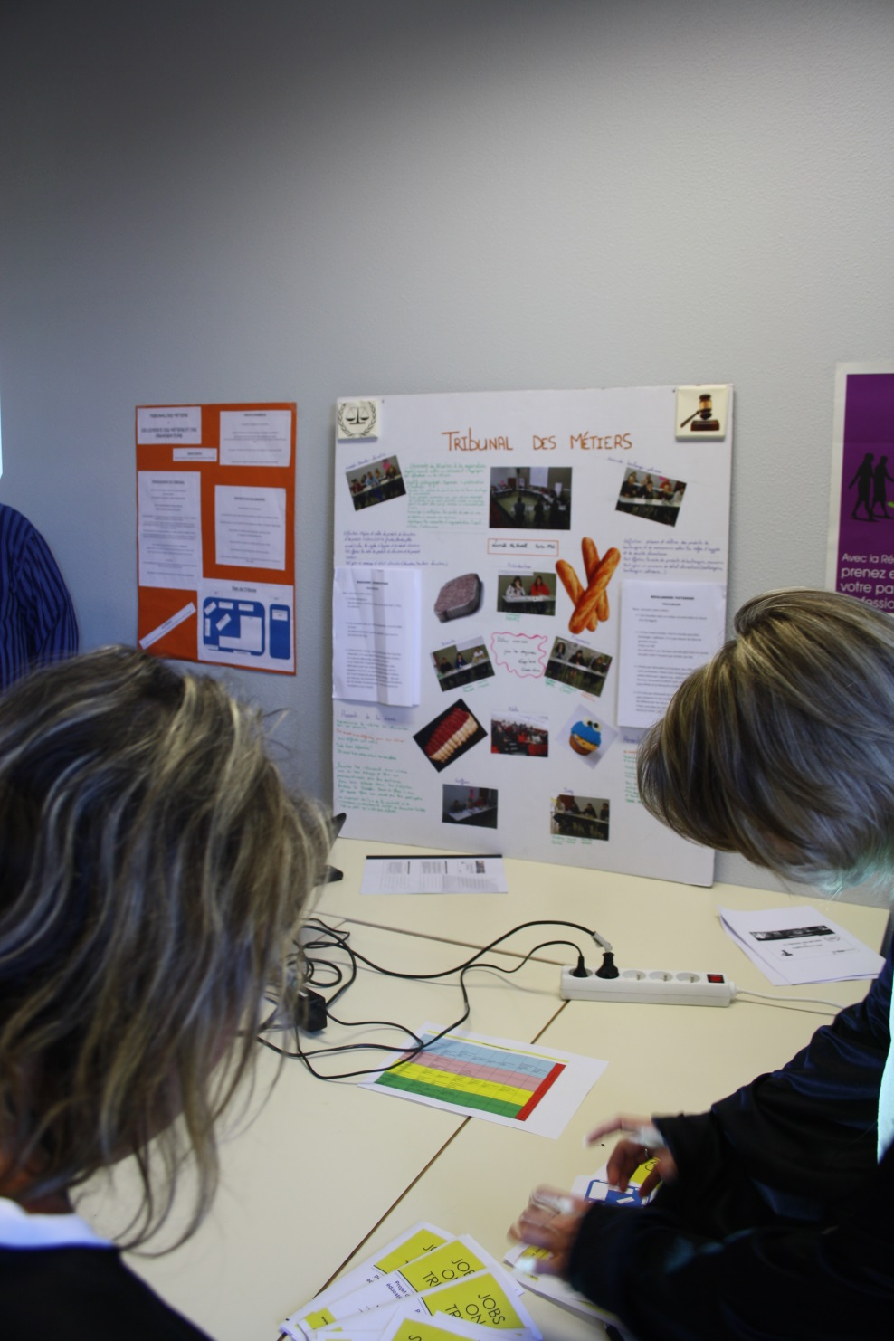
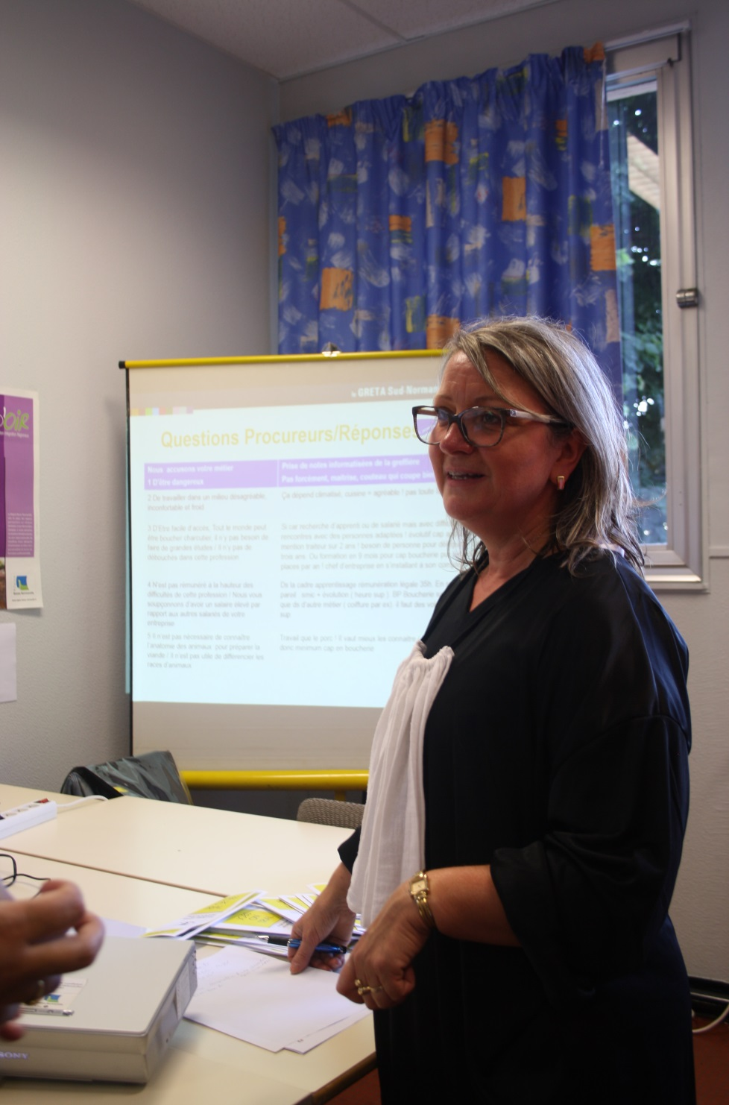

Slide 7
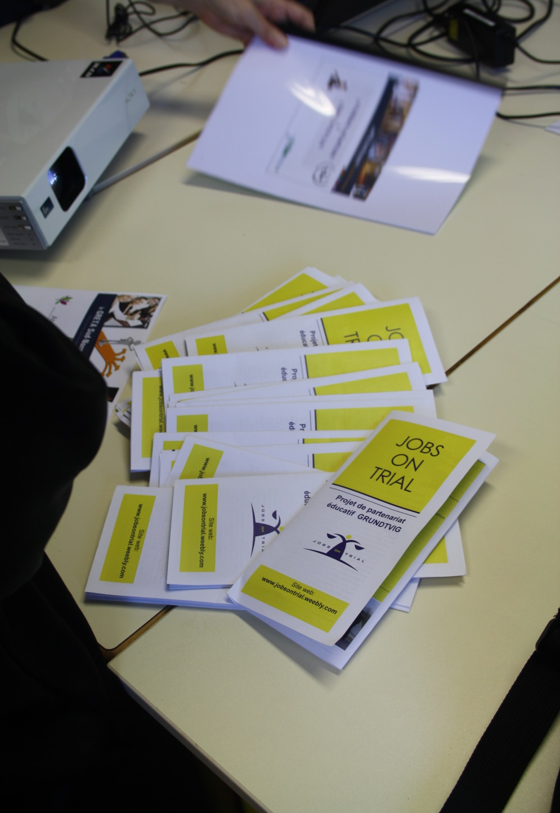
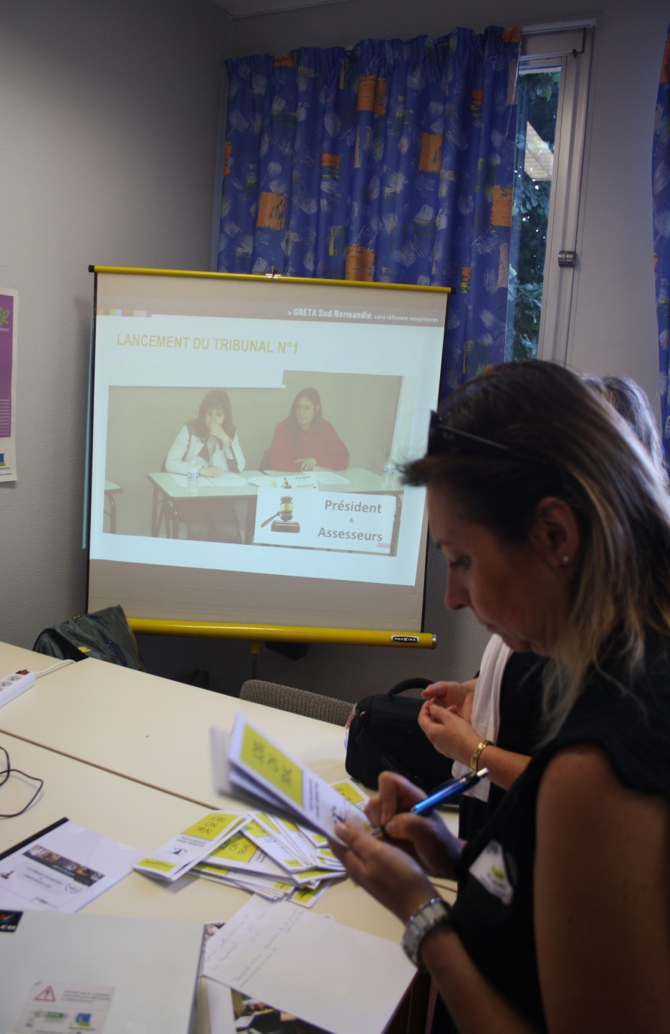

Slide 8
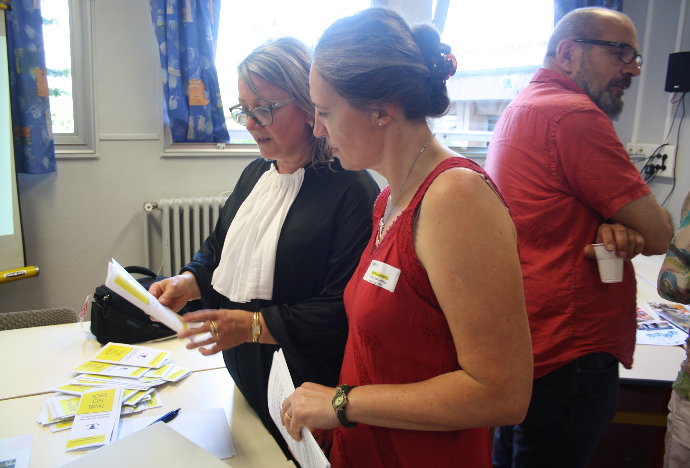

Slide 9
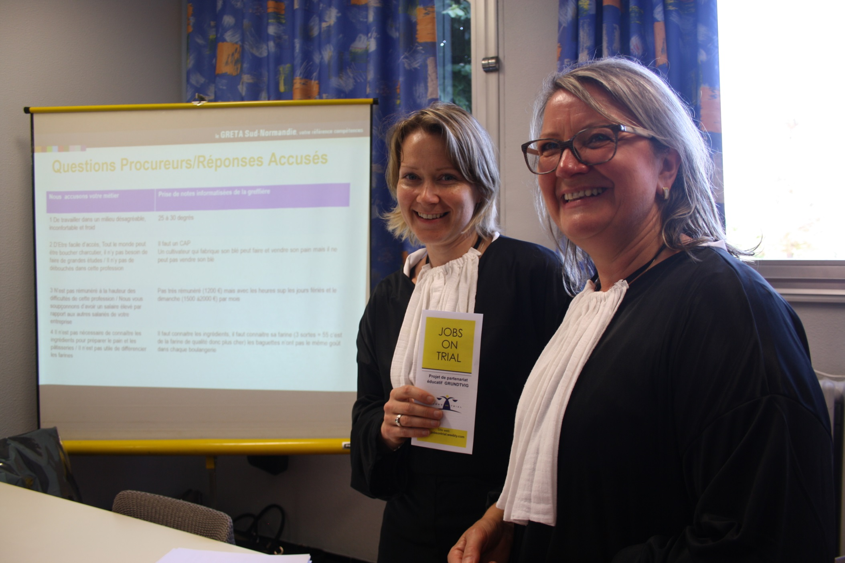

Slide 10
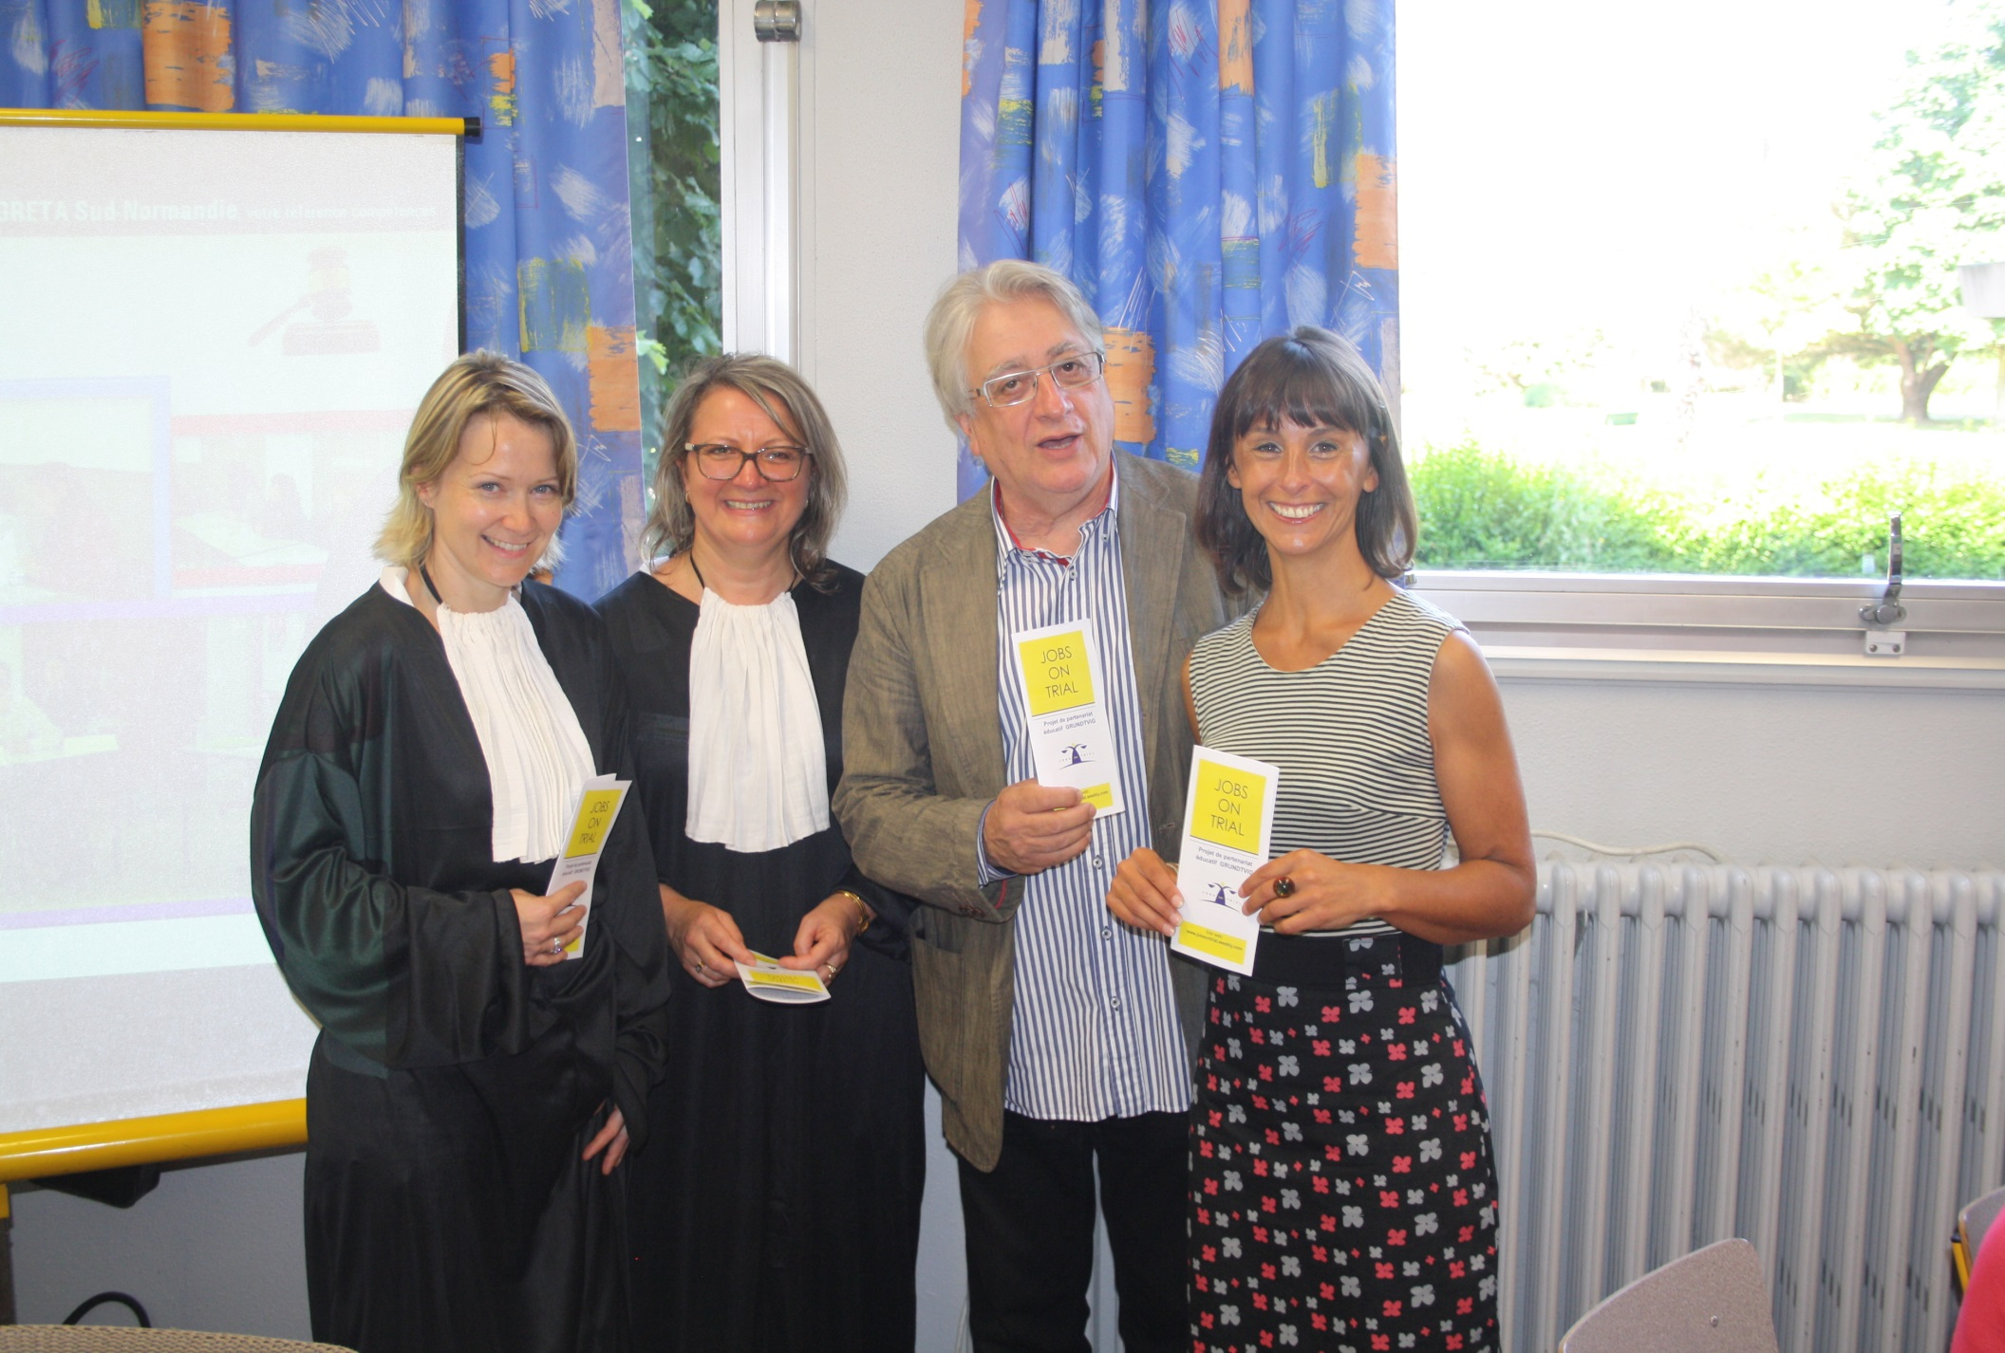

Slide 11
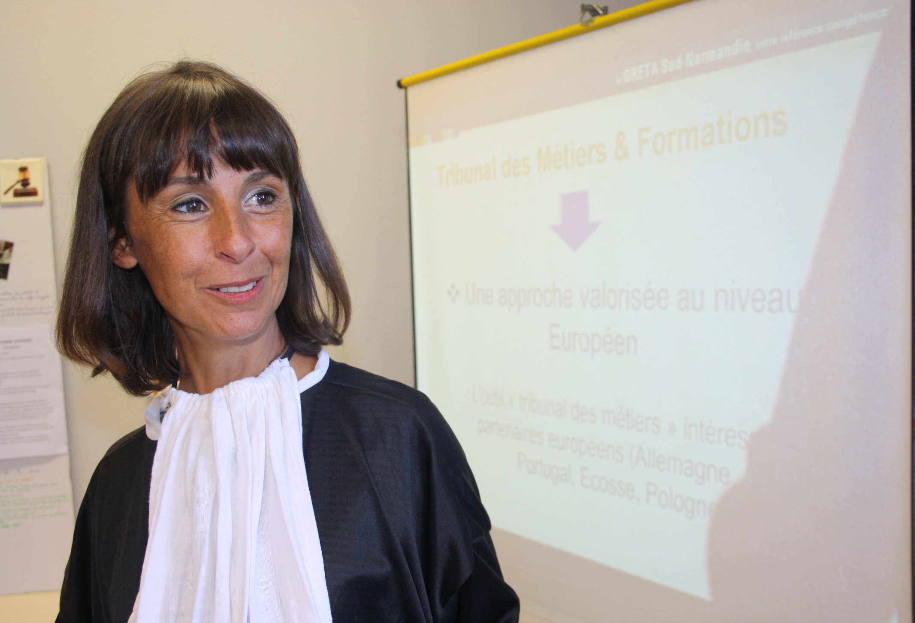

Slide 12
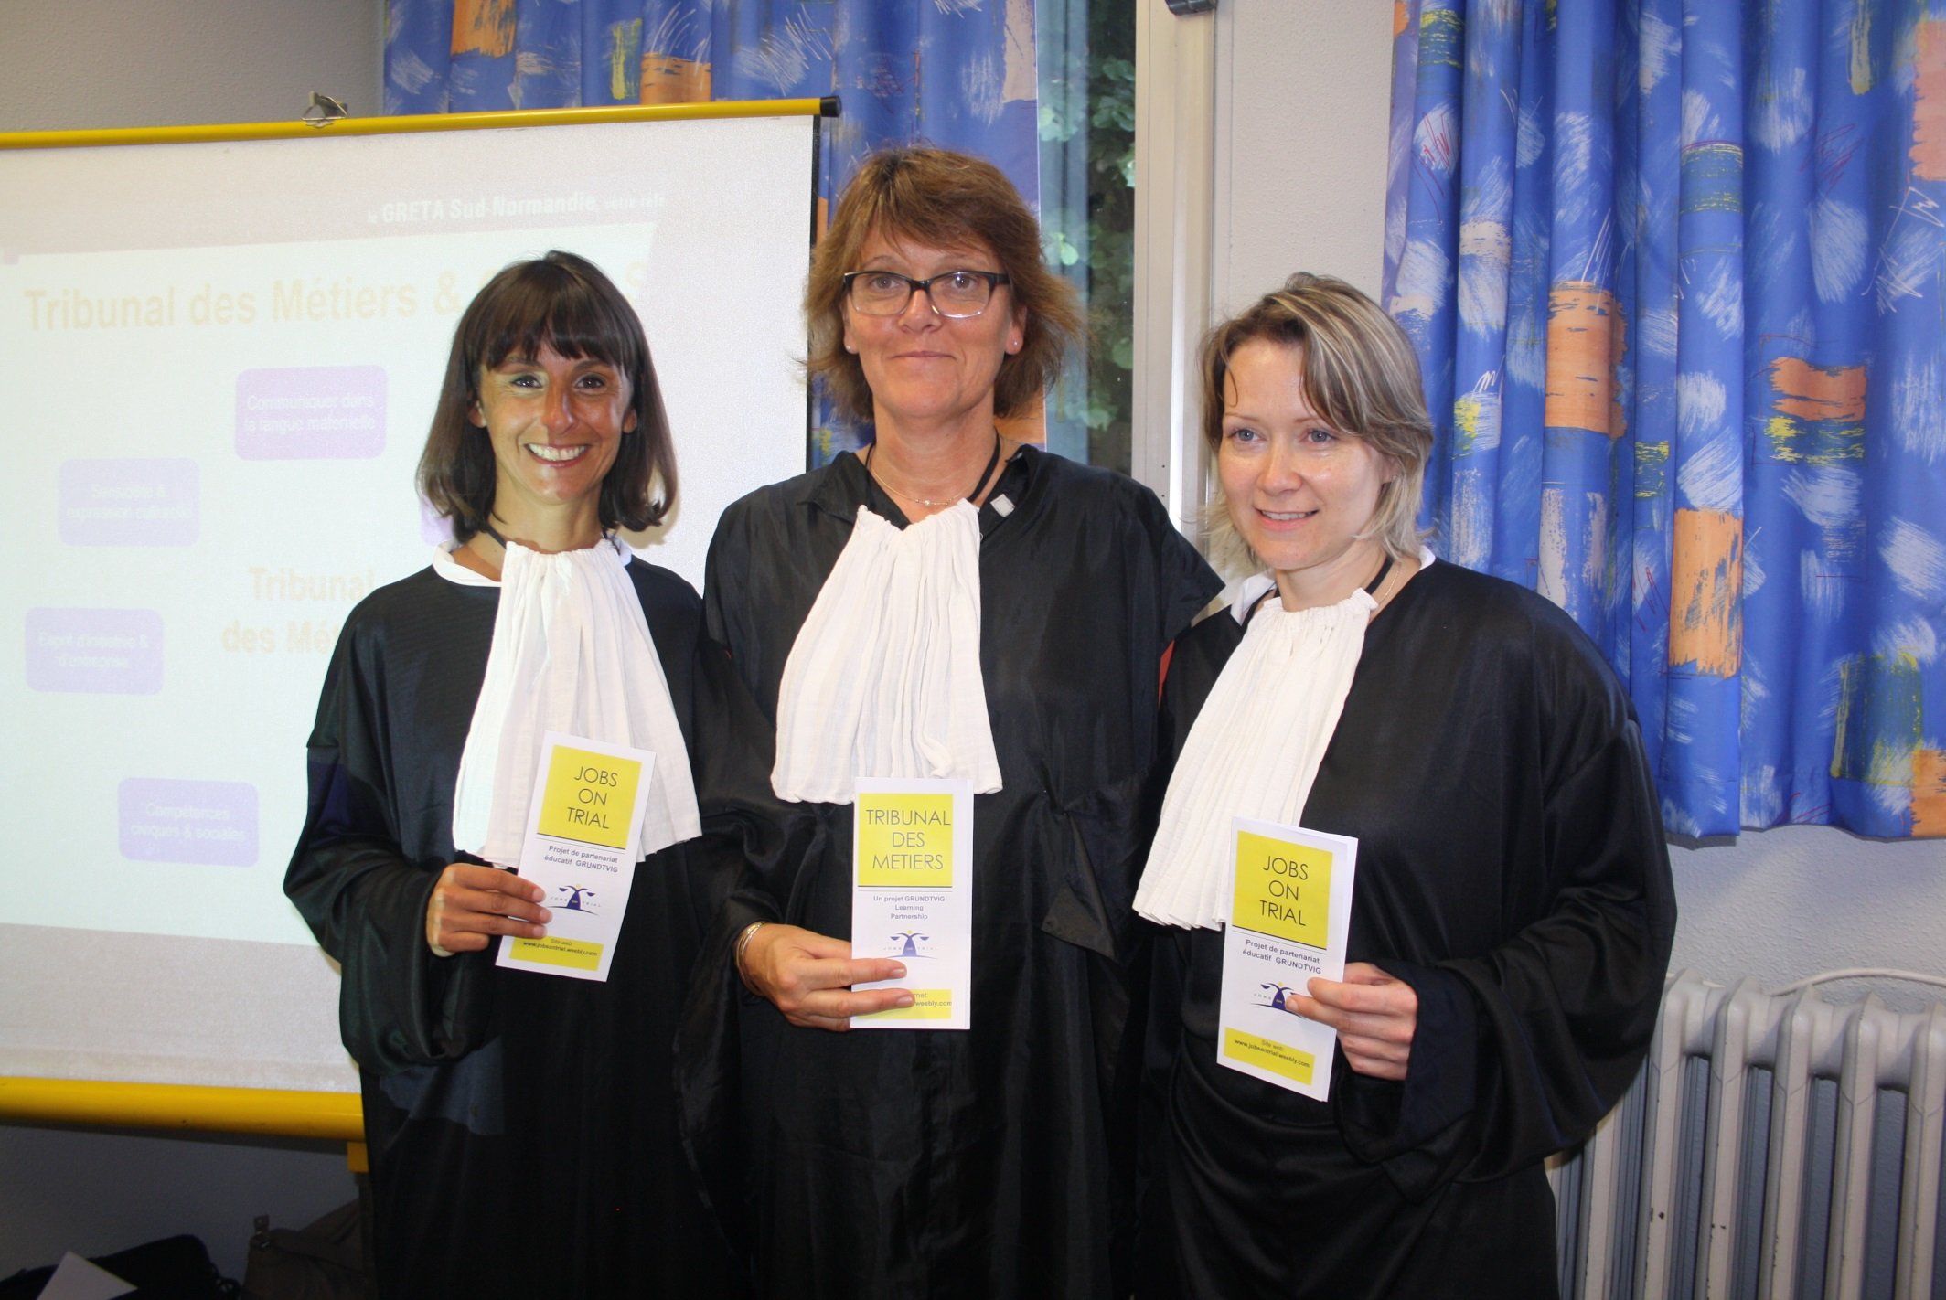

Slide 13
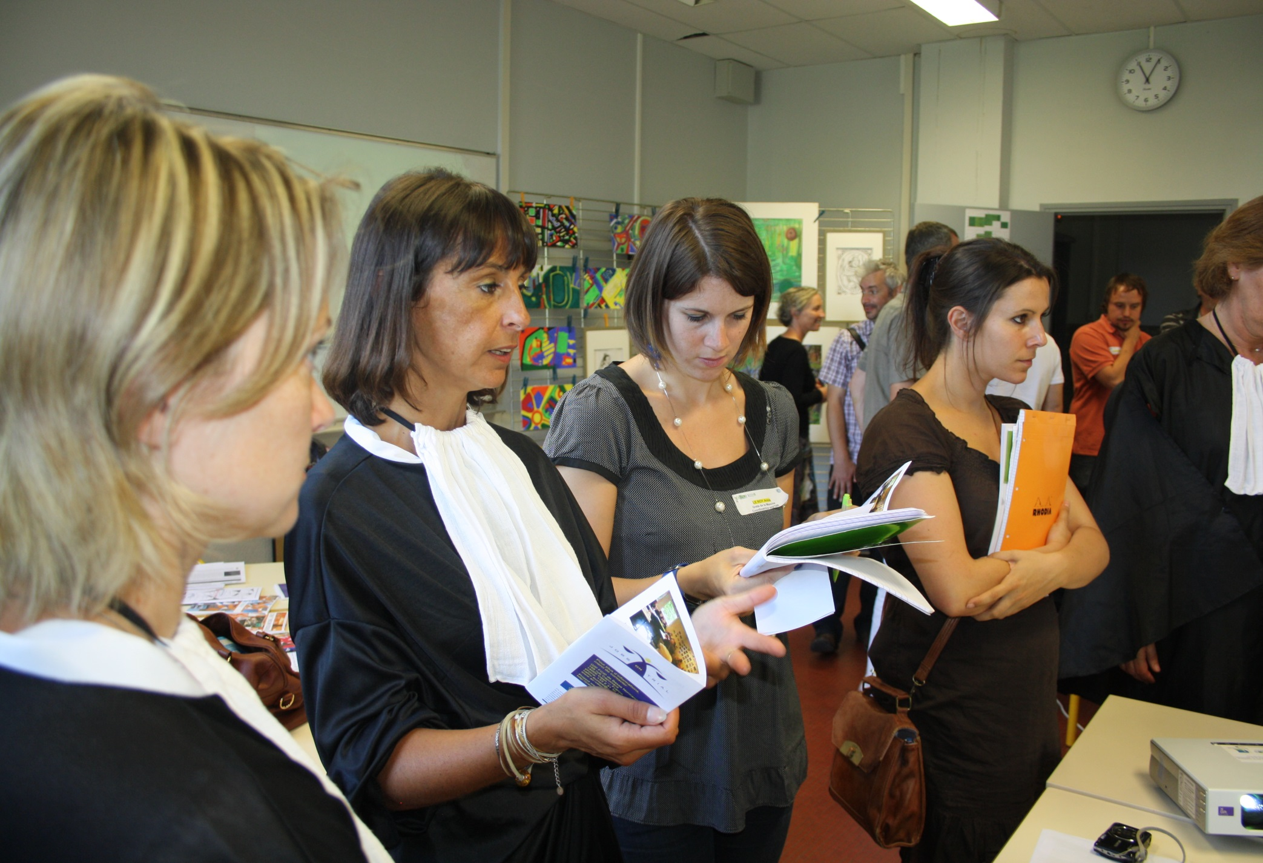

Slide 14
